Slide 1
Self-Checking Test-bench
By Harsh Devda

Slide 2
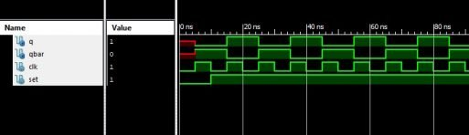

Slide 3
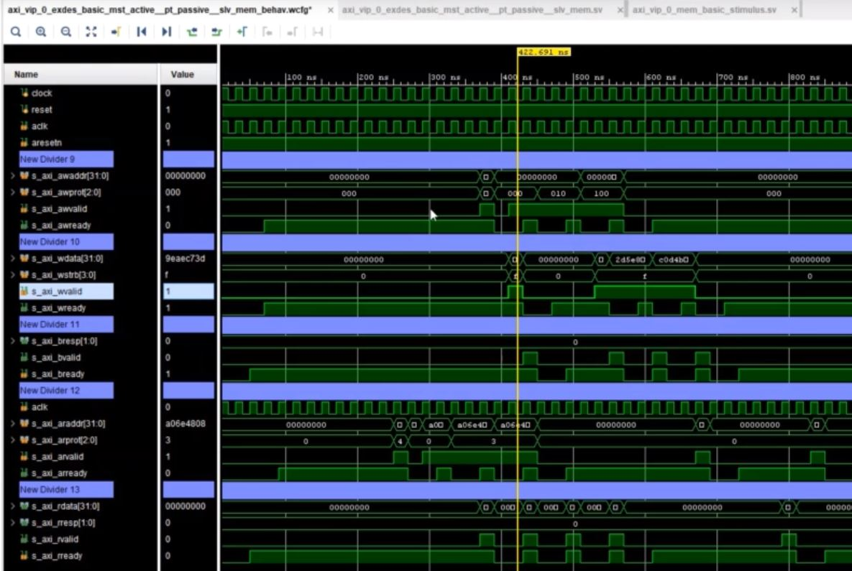

Slide 4
What is a self checking test-bench
A self-checking Test Bench checks expected results against actual results obtained from the simulation.
Although Self-checking testbenchs require considerably more effort during the initial test bench creation phase, this technique can dramatically Reduce the amount of effort needed to re-check a design after a change has been made to the DUT.
Two parts – (1) Mimicking the specifications and getting a design ready.
(2) checker part for comparing Actual and Expected Outputs.

Slide 5
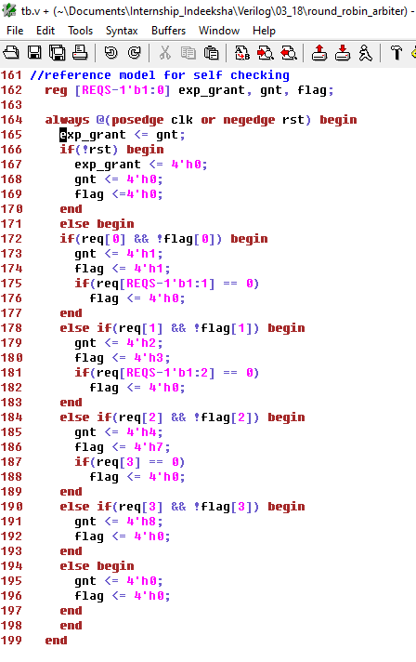
1. Mimicking the specifications.

Slide 6
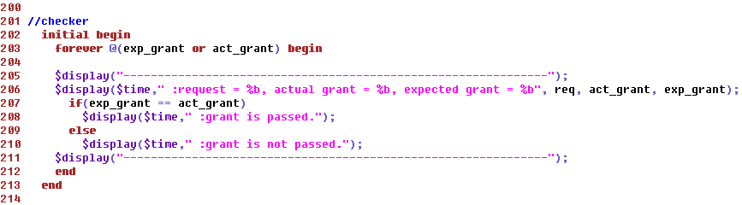
2. Checker for comparing the Outputs.

Slide 7
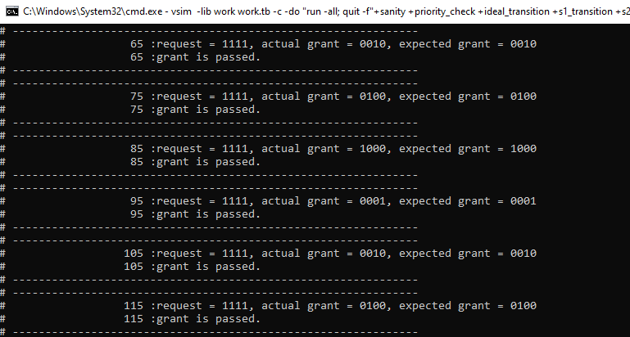
Output

Slide 8
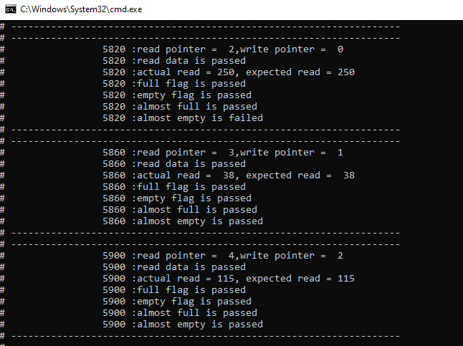
Test-case failure due to Delta sim-time difference

Slide 9
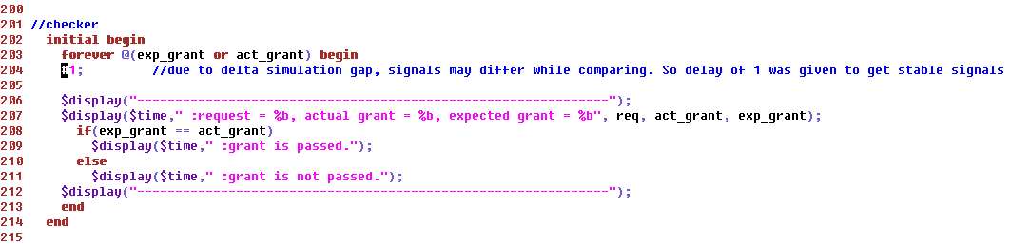
Delay of 1 is added

Slide 10
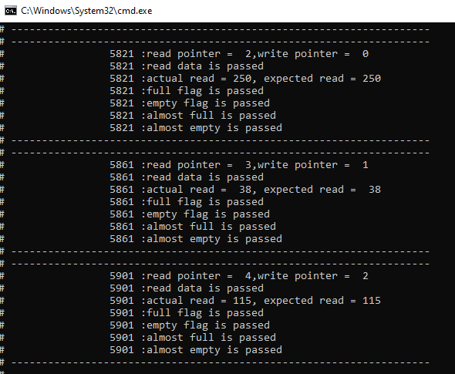
Failed test-case passes

Slide 11
THANKS

